Slide 1

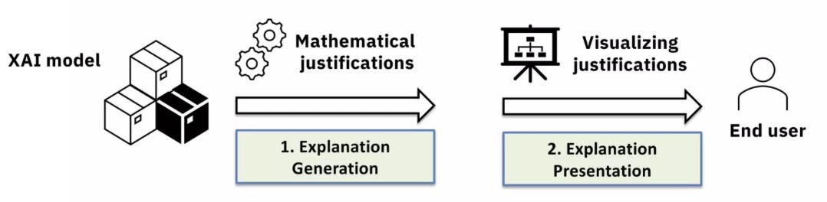
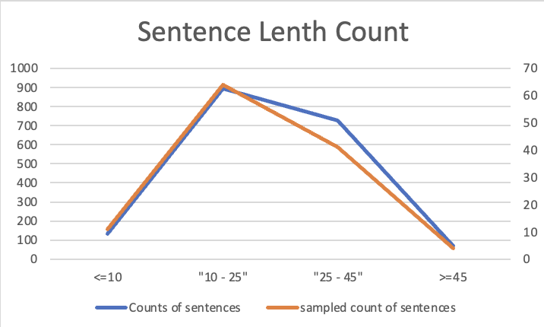
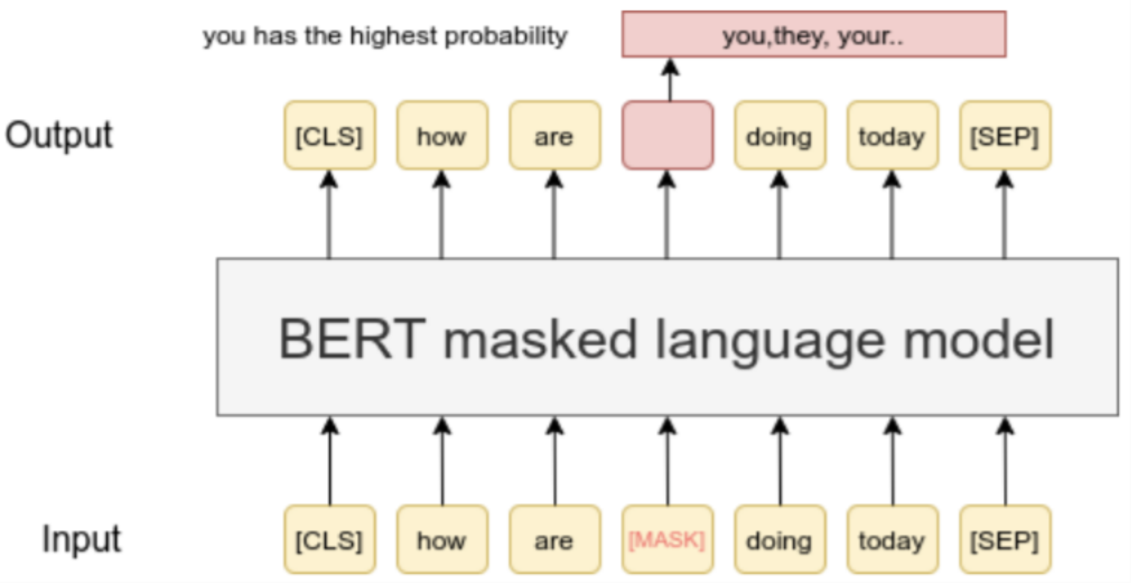
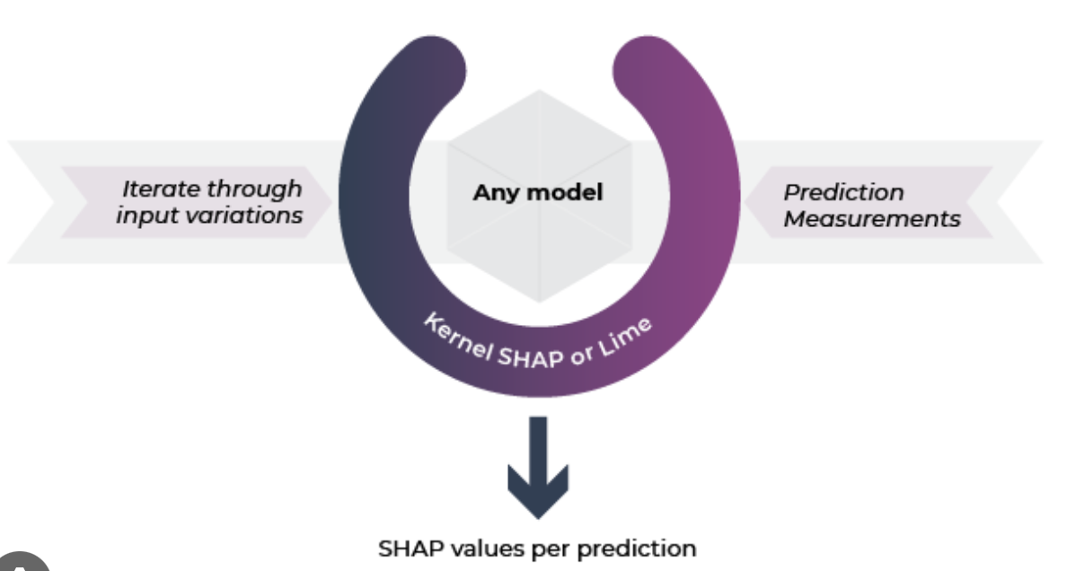
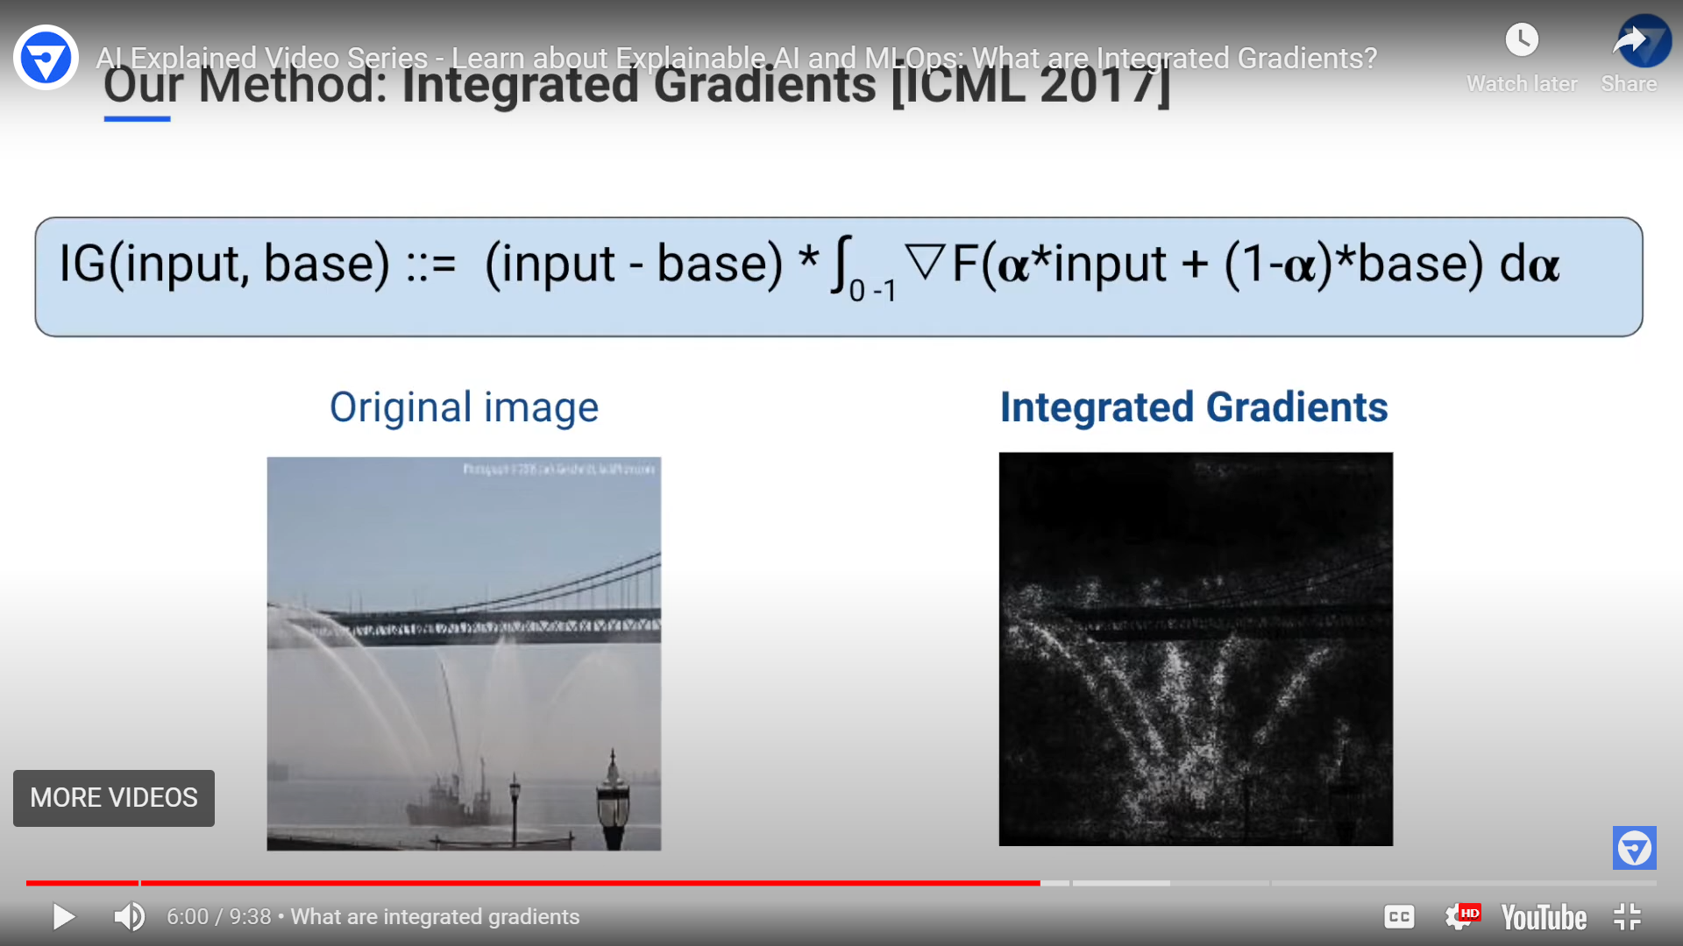
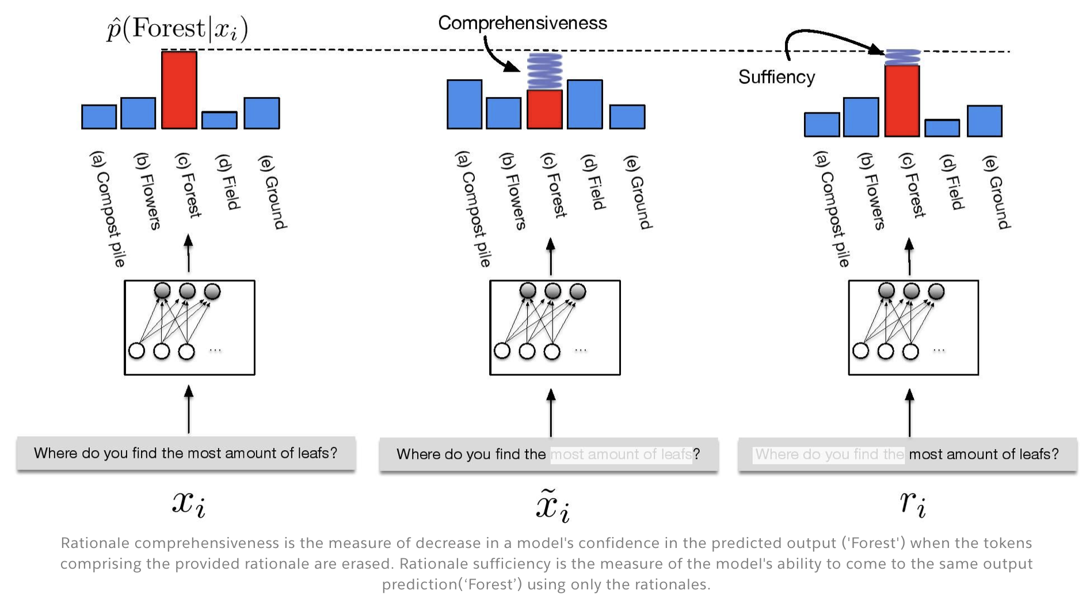
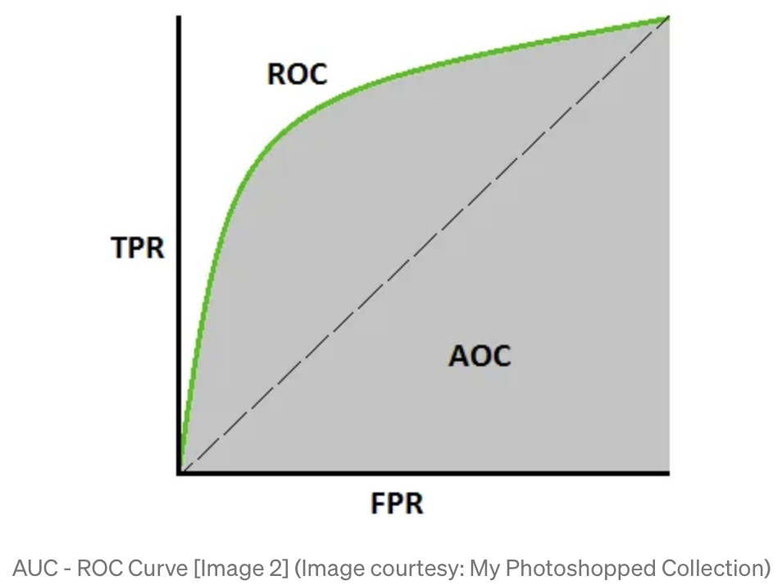
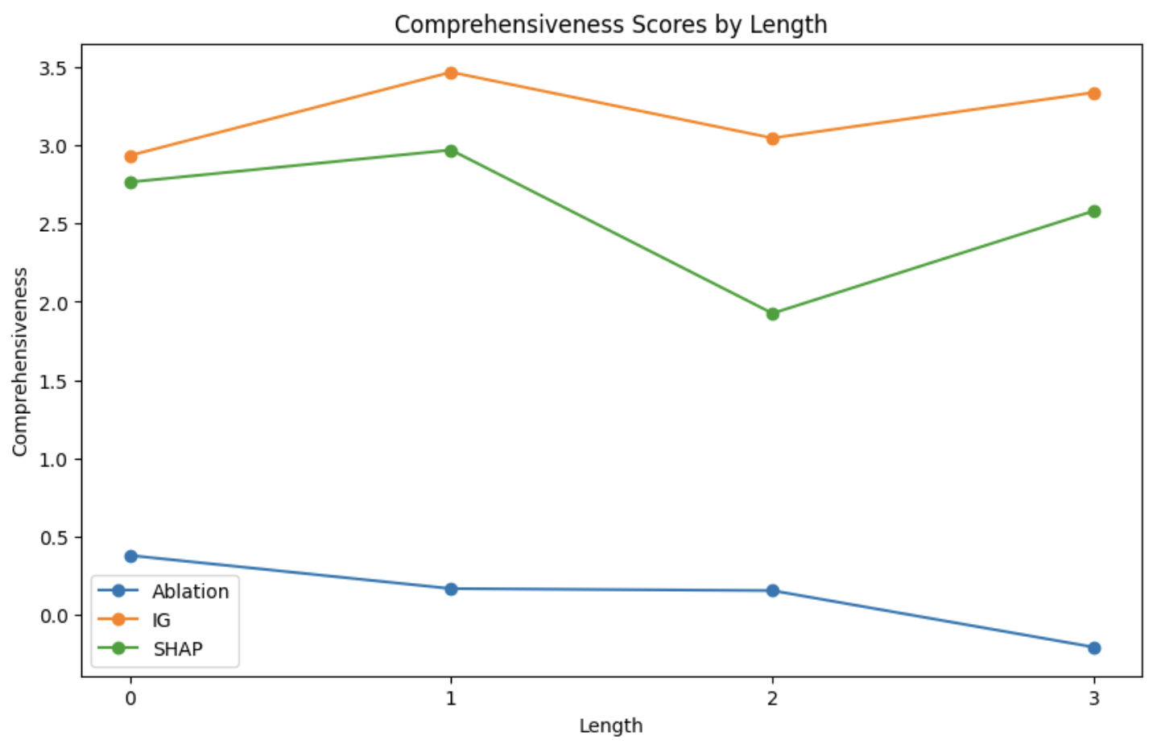
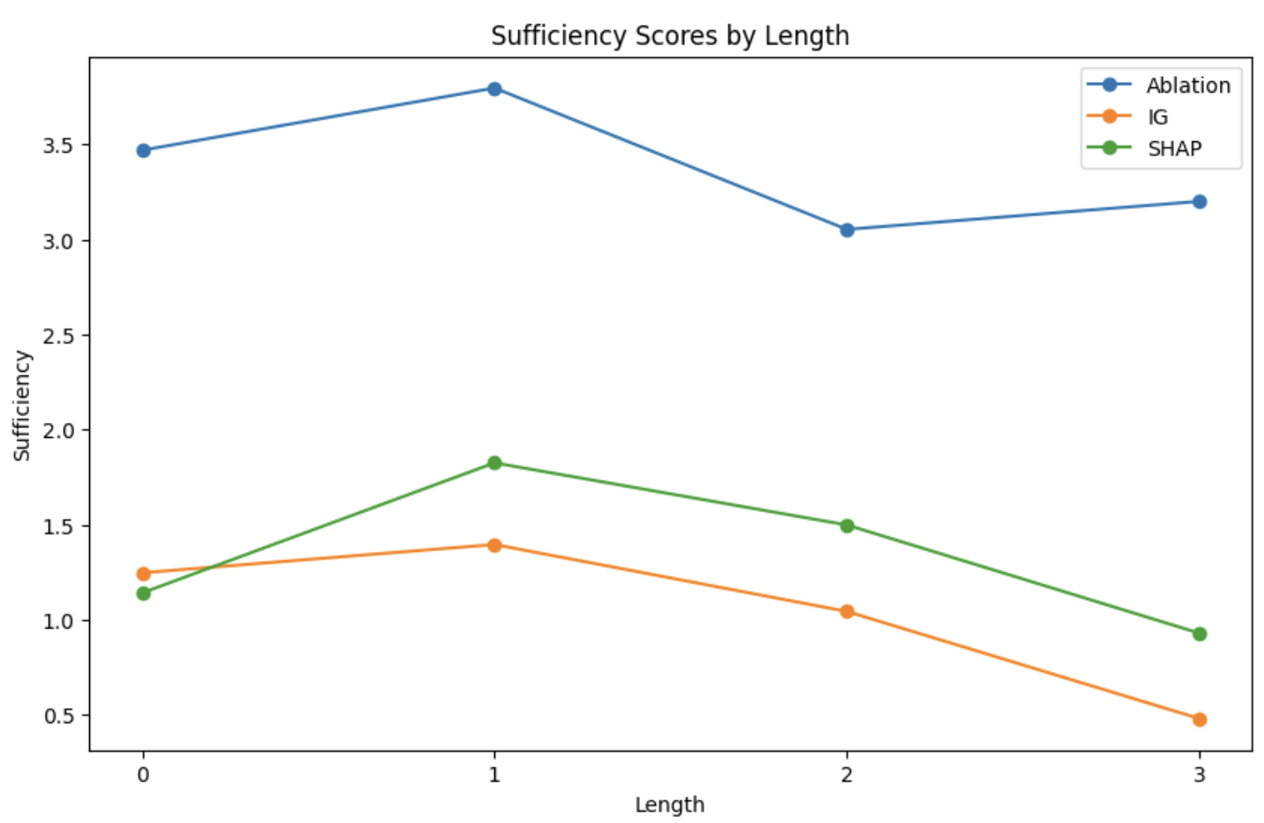
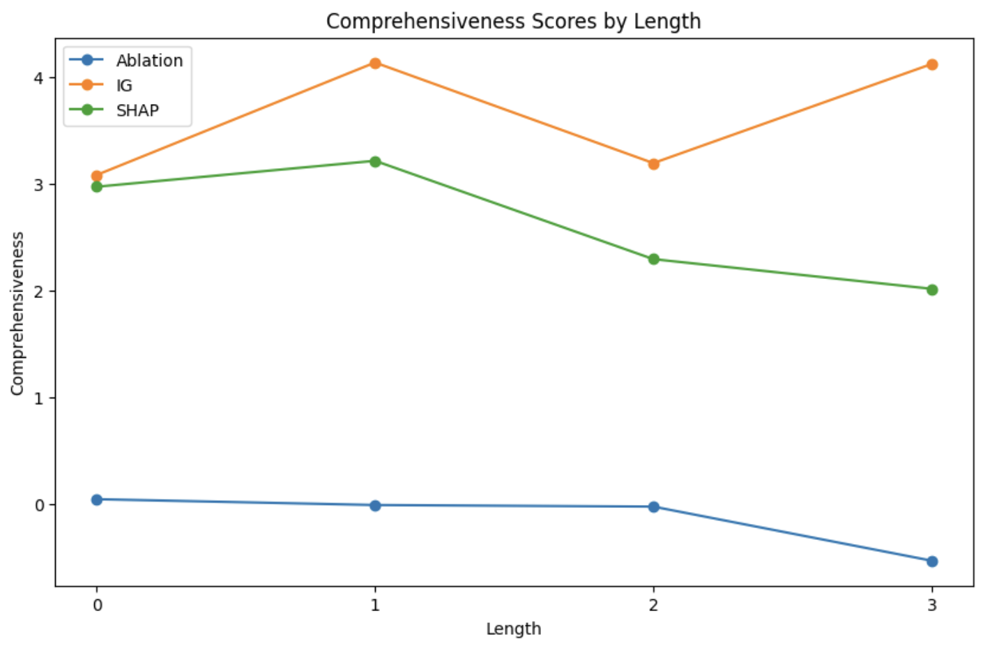
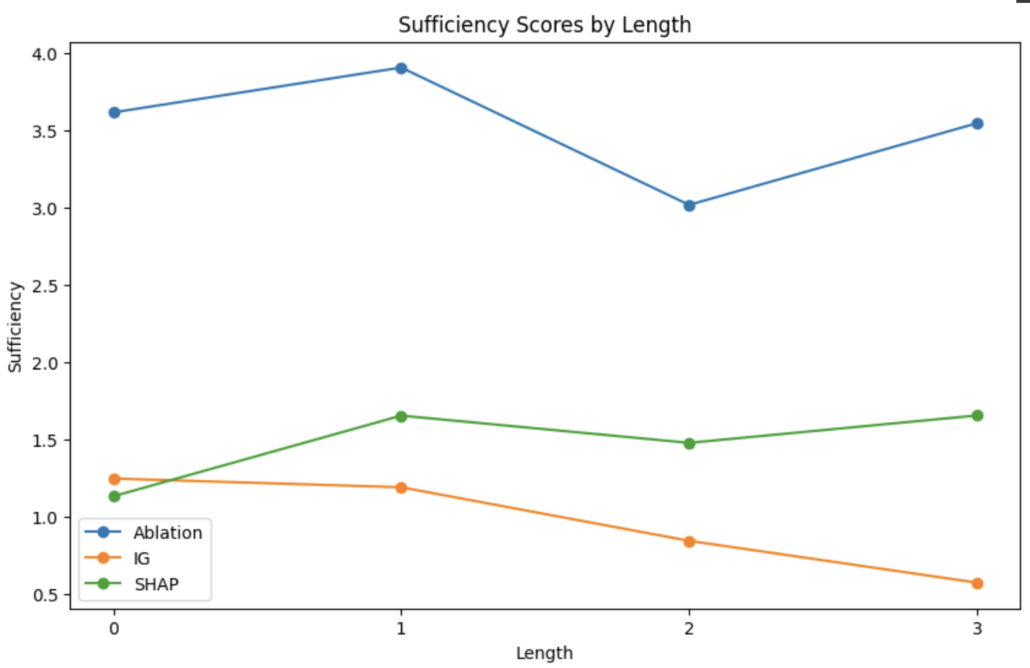
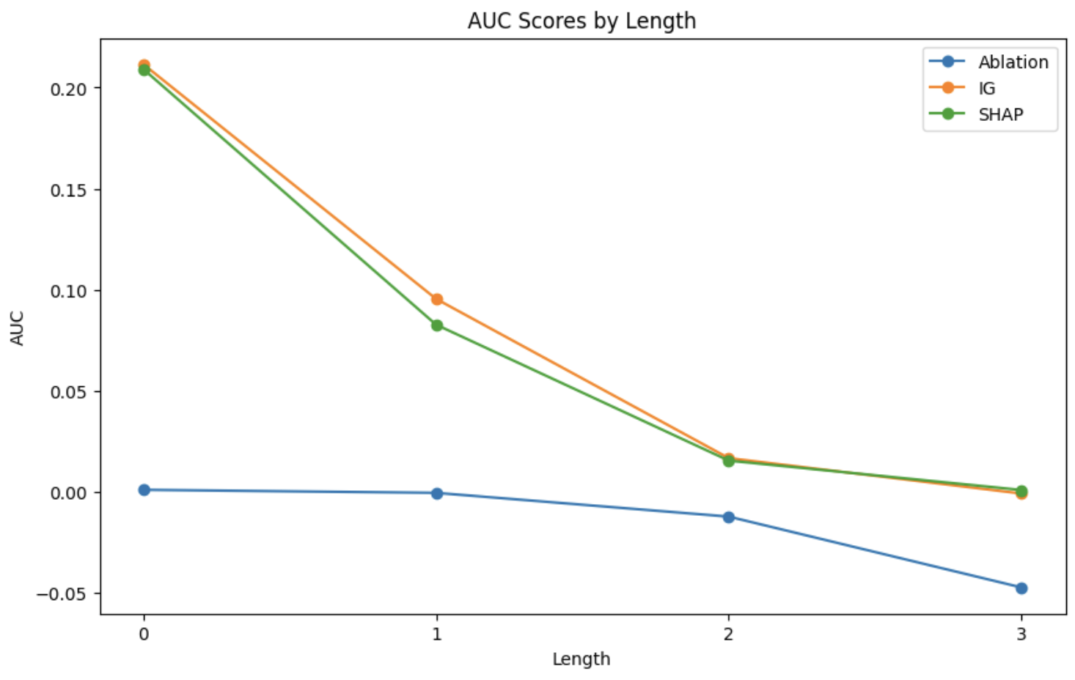
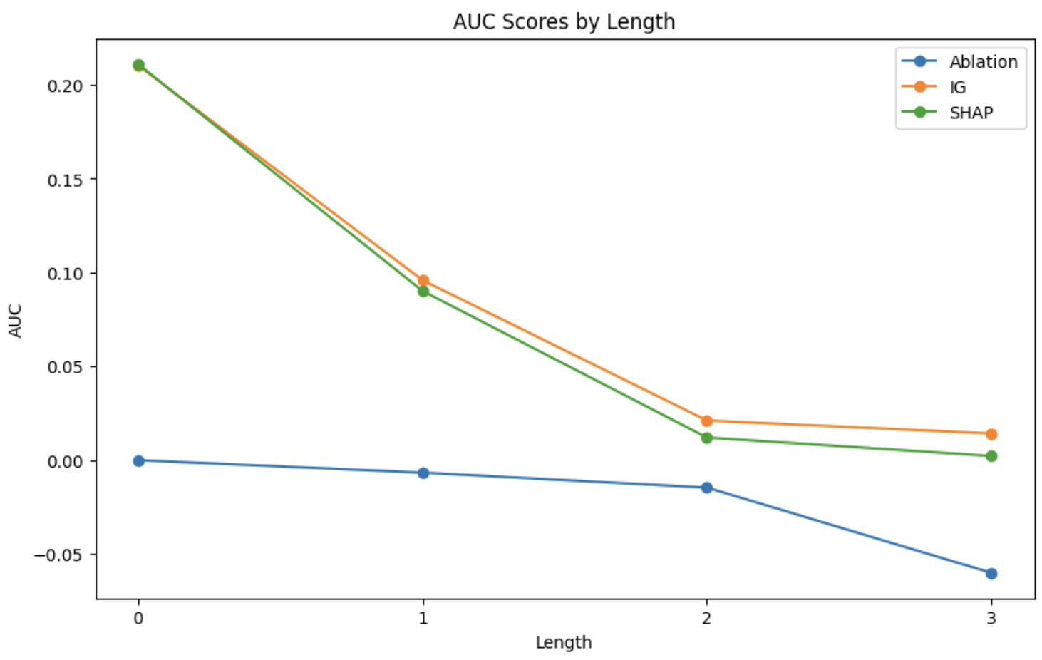
Exploring the Impact of Sentence Length on Attribution Evaluation Scores
Tanya Kaintura, Payanshi Jain
Motivation
Hypothesis: Longer sentences tend to receive lower attribution evaluation scores due to the presence of complex linguistic interactions.
Word phrases and idiomatic expressions often found in longer sentences convey meaning or sentiment as a whole, making semantics of a sentence independent of individual words[1][2].
Importance of word phrases: The presence of word phrases as shortcuts in longer sentences highlights the need to understand their impact on attribution methods, as they can significantly influence the evaluation of feature importance.
Methodology
1) RoBERTa Model
2) Weighted Random Sampling Approach:
RoBERTa is an extended version of BERT trained on a large corpus with longer sequences.
RoBERTa has the same architecture as BERT but uses a byte-level BPE as a tokenizer and uses a different pretraining scheme.
Iterate through the corpus and calculate the length of each sentence.
Creating in four buckets: based on length range(<=10, >10 & <=25, >25 & <=45, and <45).
Weighted Radom sampling: Based on the above distributions applied weighted random sampling to obtain 120 samples.
Stanford Sentiment Treebank Dataset
Characteristics:
11,855 movie reviews
Each annotated with sentiment
3) Feature Attribution Methods:
Feature Ablation:
2. Shapley Values (KernelSHAP):
3. Integrated Gradients:
4) Evaluation:
1. Comprehensiveness
Comprehensiveness is an evaluation metric used to assess the attribution methods' ability to capture the overall contribution of the features or tokens in a sentence.
2. Sufficiency
Sufficiency is an evaluation metric that measures whether the attribution methods can accurately identify the minimal set of features necessary to make a decision.
3. Area:
Area is an evaluation metric used to assess the overall quality of the attribution scores by considering the entire range of possible feature subsets.
Experiments and Results
Evaluation vs Length of sentences for different Attribution method
UNK Baseline
ZERO Baseline
PAD Baseline – the graphs followed the same pattern as UNK
Conclusion
Limitations
Limited Attribution Methods
Scope of Linguistic Interactions
Sample Size and Diversity
Need for Further Investigation
Based on the provided tables and the given hypothesis, the following conclusions can be drawn
Comprehensiveness and Sufficiency: It can be observed that longer sentences generally receive lower attribution evaluation scores. This supports the hypothesis that longer sentences tend to have lower attribution scores.
AUC (Area Under the Curve): The AUC scores provide an overall measure of the performance of the attribution methods. While the AUC scores vary across the different baselines and sentence lengths, there is no clear pattern indicating a direct relationship with sentence length. Therefore, the hypothesis regarding the influence of sentence length on AUC scores is inconclusive based solely on the provided data.
References
[1]:Mengnan Du1∗, Varun Manjunatha2, Rajiv Jain2, Ruchi Deshpande3, Franck Dernoncourt2, Jiuxiang Gu2, Tong Sun2 and Xia Hu1. Towards Interpreting and Mitigating Shortcut Learning Behavior of NLU Models , 2021.
[2]:Yoon Kim. Convolutional Neural Networks for Sentence Classification. ArXiv preprint arXiv:1408.5882, 2014.

